Slide 1
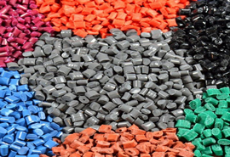
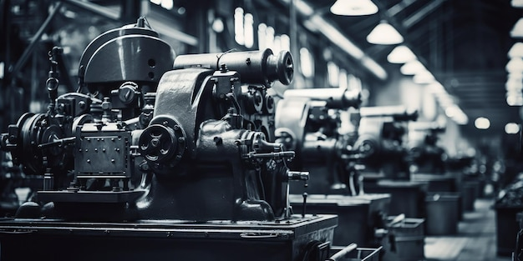
GROWEST E-AUCTIONEERS LIMITED
UNLOCKING OPPORTUNITIES: INNOVATIVE PLASTIC GRANULES MANUFACTURING

Slide 2
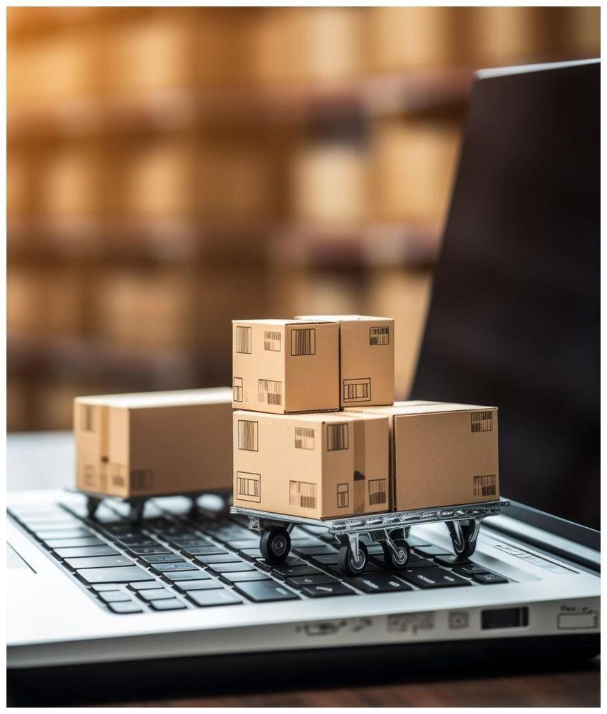
INTRODUCING: GROWEST E-AUCTIONEERS LIMITED
GROWEST E-AUCTIONEERS LIMITED is the renowned leader in the plastic recycling industry and the fastest growing organization, specializing in high-quality plastic granules for various sectors, including packaging, automotive, furniture, pipes, and construction. With a cutting-edge manufacturing facility and a team of skilled professionals, we deliver products that uphold the highest standards of quality and sustainability. Our commitment to eco-friendly practices and recyclable materials reflects our dedication to addressing global challenges posed by plastic waste, ensuring minimal waste and maximum value. At the heart of our operations is a passion for innovation, excellence, and customer satisfaction. We prioritize personalized client solutions, offering precision and trust in every interaction. As the demand for plastic granules grows, we continue to lead the way by integrating advanced technologies, focusing on sustainability, and maintaining a client-oriented approach.
Vision:
To revolutionize the plastic industry through innovative, technology-driven manufacturing solutions, creating value and fostering sustainable growth for businesses globally.
Mission:
Our mission is to leverage cutting-edge manufacturing technologies to drive innovation in plastic granules production, unlocking new opportunities and ensuring high-quality, efficient, and transparent processes for businesses and customers alike.

Slide 3
GAPS IN THE INDUS TRY FOR PLASTIC GRANULE MANUFACTURING & TRADING
Industry Challenges
!
!
!
!
Raw Material Availability
Increasing Demand in RM
Technological Advancements
Quality Consistency
Inconsistent availability of raw materials and frequent price fluctuations create challenges in maintaining stable production and pricing.
Due to increasing Ratio in polymers recycled granules, there are huge demands in the plastics industry in India and Oversea.
Limited adoption of advanced machinery and techniques can reduce production efficiency and competitiveness.
Ensuring consistent high quality in granules is a challenge due to varying raw material sources and manufacturing processes.

Slide 4
OUR SOLUTIONS!
Addressing Industry Challenges
Securing Raw Material Supply
To ensure a reliable supply of raw materials, businesses can focus on building long-term contracts with trusted traders and suppliers. Owning or partnering with manufacturing plants can also provide better control over raw material availability and reduce reliance on external sources.
Embracing Sustainability
Manufacturers can adopt bio-based or recycled materials to align with environmental regulations. Implementing eco-friendly production processes and obtaining certifications can further enhance compliance and market appeal.
Adopting Advanced Technology
Investing in modern machinery and automation can improve efficiency, reduce waste, and enhance production capacity. Advanced quality control systems can also ensure higher consistency in product standards.
Ensuring Quality Control
Implementing stringent quality management systems and testing protocols can ensure consistent granule quality. Partnering with certified suppliers for raw materials can also improve reliability and customer trust.

Slide 5
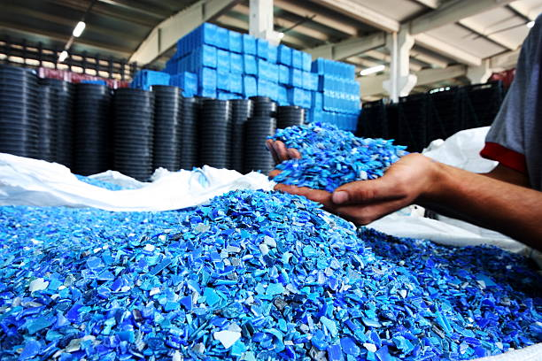
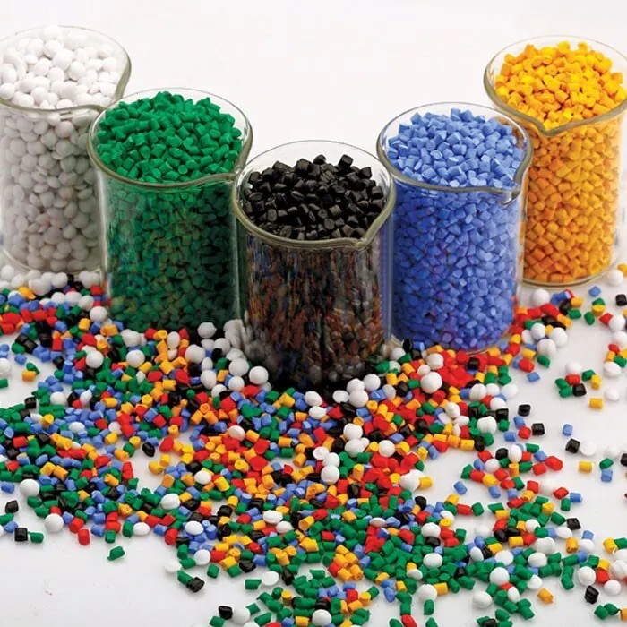
OUR SERVICES
Plastic Granule Manufacturing
GROWEST E-AUCTIONEERS LIMITED specializes in the manufacturing and trading of plastic granules, producing a diverse range of products.
Plastic Granule Recycling
GROWEST E-AUCTIONEERS LIMITED promotes sustainability with high-performance recycled granules. These eco-friendly materials provide a cost-effective solution while supporting your green initiatives.

Slide 6
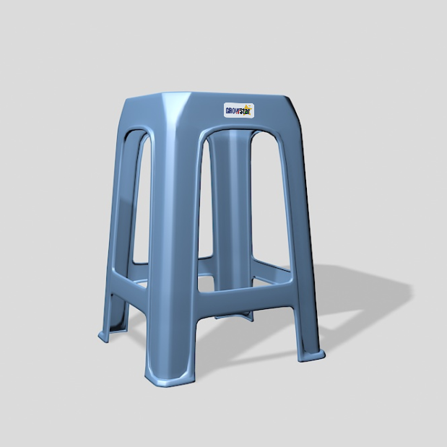
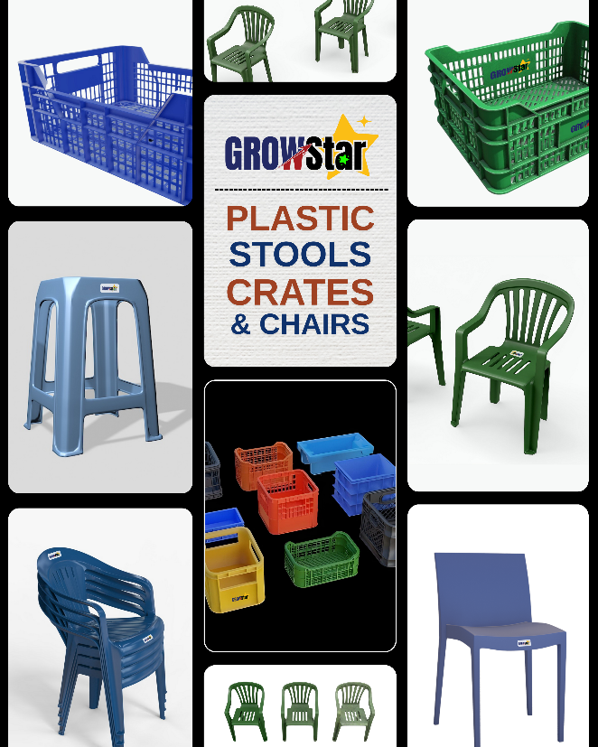
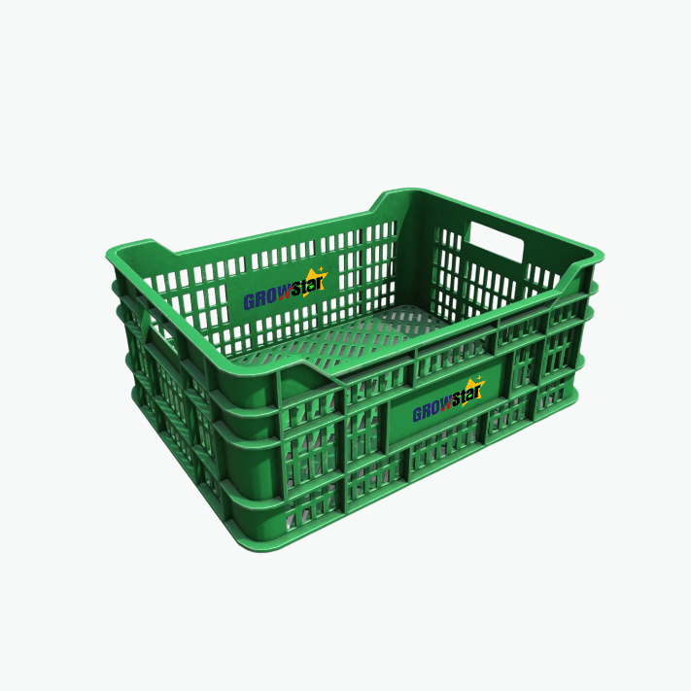
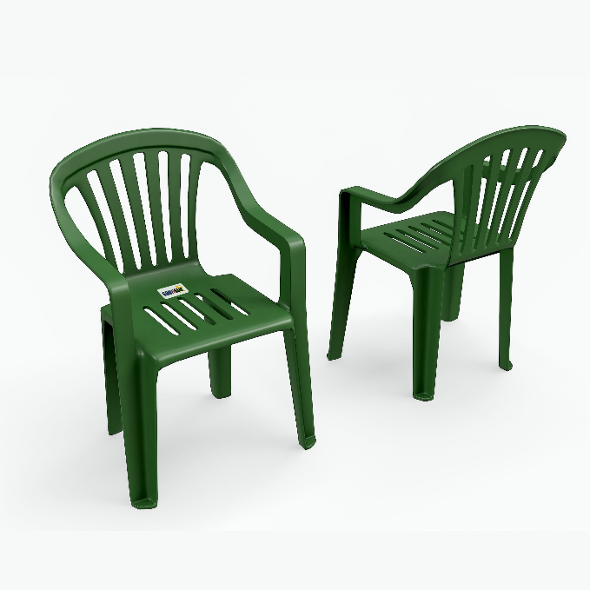
Product Line
COMING SOON

Slide 7
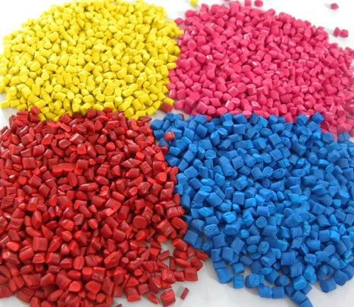
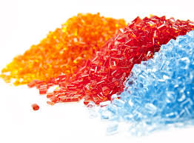
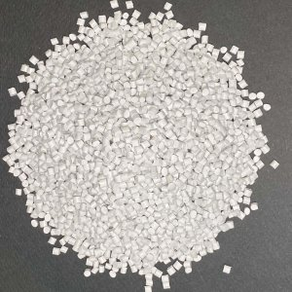
Types of Plastic Granules; GROWEST Products
GROWEST E-AUCTIONEERS LIMITED likely deals in various types of plastic granules, commonly used for plastics products manufacturing and industrial applications. Based on the types of plastics mentioned, they may offer:
Polyethylene (PE) Granules
Suitable for flexible packaging, agricultural films, and other versatile applications.
Polypropylene (PP) Granules
Used in automotive components, containers, and medical devices
Polyethylene Terephthalate (PET) Granules
Ideal for making water bottles, food-grade containers, and synthetic fibers.
High-Density Polyethylene (HDPE) Granules
Used in rigid products like milk jugs, fuel tanks, and pipes.
Low-Density Polyethylene (LDPE) Granules
Suitable for plastic bags, cling wrap, and lightweight packaging materials.

Slide 8
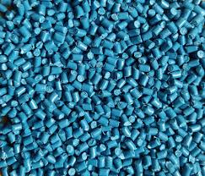
PLASTIC Granule MANUFACTURING
GROWEST E-AUCTIONEERS LIMITED stands as a trusted leader in the plastic industry, specializing in the production of premium-quality plastic granules. With a cutting-edge manufacturing facility and a highly skilled team, we deliver products that set benchmarks for quality, sustainability, and versatility. Our granules cater to industries like packaging, automotive, and construction, ensuring consistent uniformity to meet diverse client needs. Sustainability is at the heart of everything we do. By embracing eco-friendly processes and utilizing recyclable materials, we actively minimize waste and maximize value, aligning with global sustainability goals. Our passion for innovation and excellence, coupled with a commitment to personalized client services, positions us as a reliable partner in this dynamic market. As demand for plastic granules grows, GROWEST E-AUCTIONEERS LIMITED leads the way, integrating advanced technology, addressing environmental challenges, and setting new industry trends. Together, we shape a future where innovation and sustainability drive progress in plastic manufacturing.
8

Slide 9
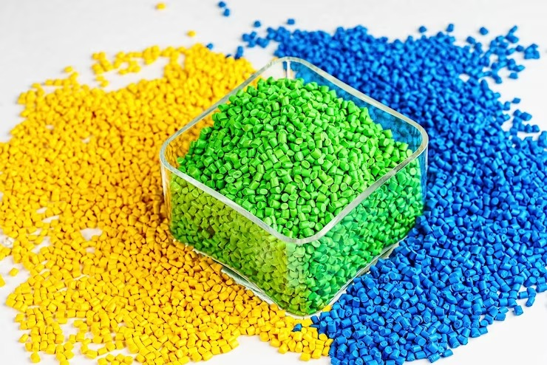
PLASTIC Granule Trading
At GROWEST E-AUCTIONEERS LIMITED we take pride in offering top-tier granules trading services tailored to meet the diverse demands of industries worldwide. Our extensive network of reliable manufacturers allows us to source and supply a wide variety of granules, including virgin and compounded types, ensuring that every client’s unique production requirements are met with precision and reliability. We understand the critical role that material consistency plays in manufacturing processes, which is why we adhere to rigorous quality control measures at every stage of procurement and delivery. Whether you need granules for packaging, automotive parts, construction materials, or other industrial applications, GROWEST E-AUCTIONEERS LIMITED is your trusted partner for premium-grade materials. By choosing GROWEST E-AUCTIONEERS LIMITED, you gain access to a broad selection of materials, competitive pricing, and a customer-centric approach designed to streamline your procurement process. Our dedicated team is always ready to assist with technical support and guidance, ensuring your operations remain efficient and cost-effective
8

Slide 10
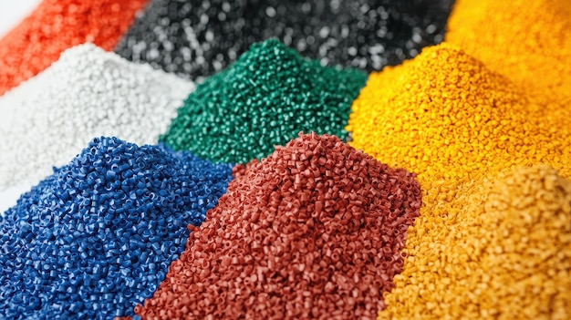
manufacturing process
At GROWEST E-AUCTIONEERS LIMITED, we specialize in producing high-quality plastic granules at competitive rates, serving industries like packaging, construction, and automotive. With a state-of-the-art manufacturing plant, we ensure consistent quality and reliable supply.
Process of Manufacturing:
1. Raw Material Preparation: Raw materials are first picked and prepared before the process starts, which can either be virgin polymers or recycled plastics. Clean and sorted to remove contaminants, recycled plastics are processed.
2. Melting: Plastic material is being prepared and plied into a large, typically metal extruder, heated to melting, thus becoming molten.
3. Extrusion: Continuous strands are made when molten plastic is forced through a die. This shape of these strands is determined by the shape of the die.
4. Cooling: The plastic is cooled extruded strands, typically through a water bath to solidify the plastic.
5. Granulation: Finally these strands turn solid and are cut into small, uniform pellets or granules with a cutting machine.
6. Drying and Packaging: Dry Granules are packaged, dried and packaged for distribution and use in manufacturing processes.
8

Slide 11
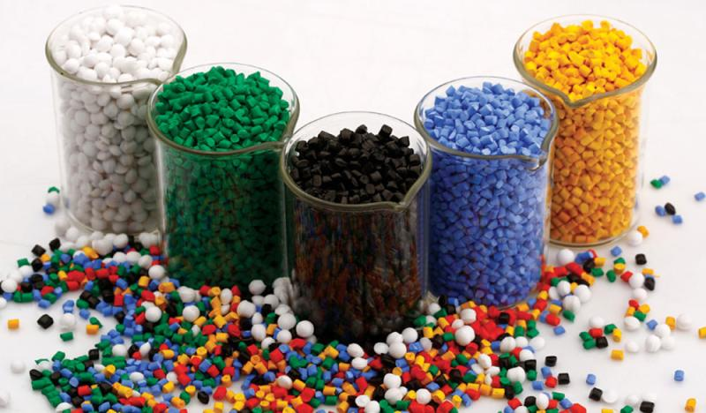
Plastic Recycling for Granule Production
Recycling plastic waste into granules is a sustainable solution to address environmental challenges while promoting resource efficiency. At GROWEST E-AUCTIONEERS LIMITED, we connect stakeholders in plastic waste management and manufacturing to streamline the recycling process.
1. Collection and Sorting: Plastic waste is collected and separated by type.
2. Shredding and Cleaning: The waste is shredded into smaller pieces and thoroughly cleaned to remove contaminants.
3. Melting and Extrusion: The cleaned plastic is melted and reshaped into granules through extrusion.
4. Cooling and Cutting: The extruded strands are cooled and cut into granules for reuse in manufacturing new products.
These granules are widely used in industries such as packaging, automotive, electronics, and construction. Granules also play a crucial role in reducing landfill waste and promoting circular economy practices.
8

Slide 12
ENVIRONMENTAL IMPACT
GROWEST E-AUCTIONEERS LIMITED is committed to minimizing its environmental footprint. By focusing on recyclable materials and sustainable practices, the company aims to contribute positively to the ecosystem while providing innovative solutions to its clients.
8

Slide 13
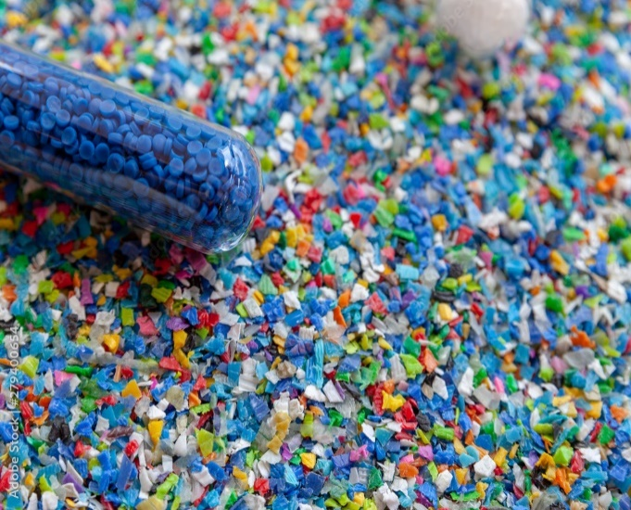
MARKET OVERVIEW OF THE PLASTIC GRANULES MANUFACTURING INDUSTRY IN INDIA
The plastic granules manufacturing industry in India is experiencing significant growth, driven by increasing demand across various sectors, including packaging, automotive, and construction. As of 2023, the Indian plastic granules market is projected to reach approximately USD 20 billion, with expectations for continued expansion due to urbanization and industrialization.

Slide 14
Key Growth Drivers
Several factors are propelling the growth of the plastic granules market in India:
Rising Consumption: India is one of the largest consumers of plastic globally, with consumption estimated at over 16 million tons annually. This high demand is fueled by population growth and urbanization, leading to increased use of plastic products in everyday life.
Government Initiatives: The Indian government has implemented various policies to promote recycling and sustainable practices. The Waste to Wealth Mission and amendments to the Plastic Waste Management Rules aim to enhance recycling rates and reduce plastic pollution. These initiatives encourage manufacturers to invest in recycled plastic granules, which are gaining traction in the market.
Technological Innovations: Advances in production technologies are improving the efficiency and quality of plastic granule manufacturing. Companies are increasingly focusing on R&D to develop specialized formulations that cater to specific industry needs, enhancing their competitive edge.
Growing Awareness: There is a rising consumer awareness regarding environmental issues associated with plastic use. This shift is leading to increased demand for eco-friendly products, including those made from recycled plastic granules.

Slide 15
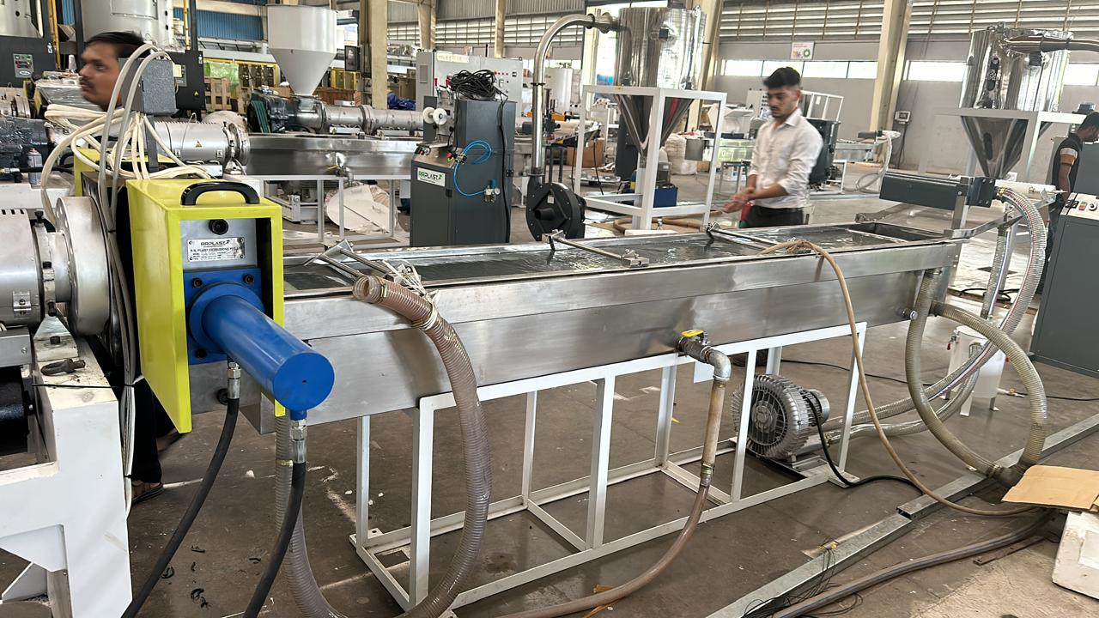
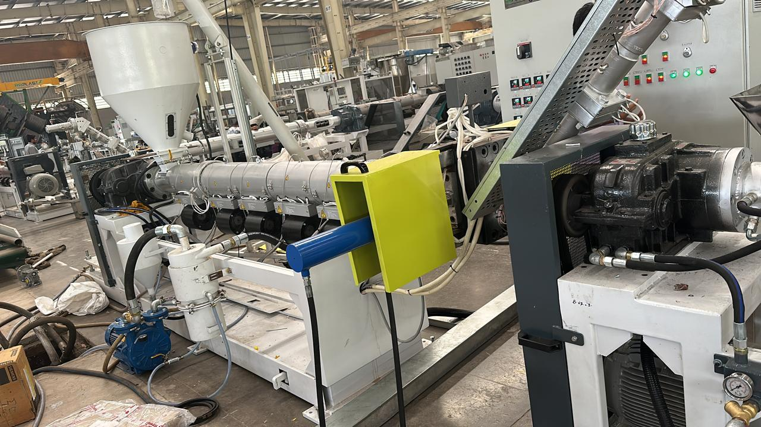
OWN PLASTIC AND granule MANUFACTURING MACHINEs
GROWEST E-AUCTIONEERS LIMITED operates its own state-of-the-art manufacturing facility equipped with advanced plastic granulation machinery. Below are four ways this setup enhances granule quality:
Precision Engineering: The machines ensure consistent size, shape, and density of granules, critical for optimal performance in various applications.
Advanced Material Handling: Equipped with temperature control and filtration systems, the facility minimizes impurities, enhancing granule purity.
Customization Capabilities: Specialized equipment allows for tailoring granules to specific industry needs, such as additives for strength, flexibility, or color.
Eco-Friendly Processes: The plant incorporates recycling technologies, reducing waste and aligning with sustainable manufacturing practices.

Slide 16
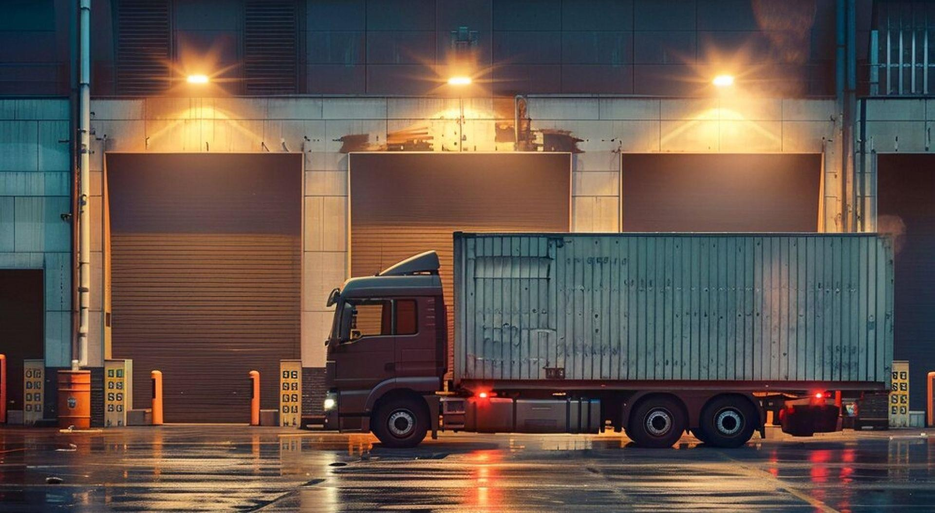
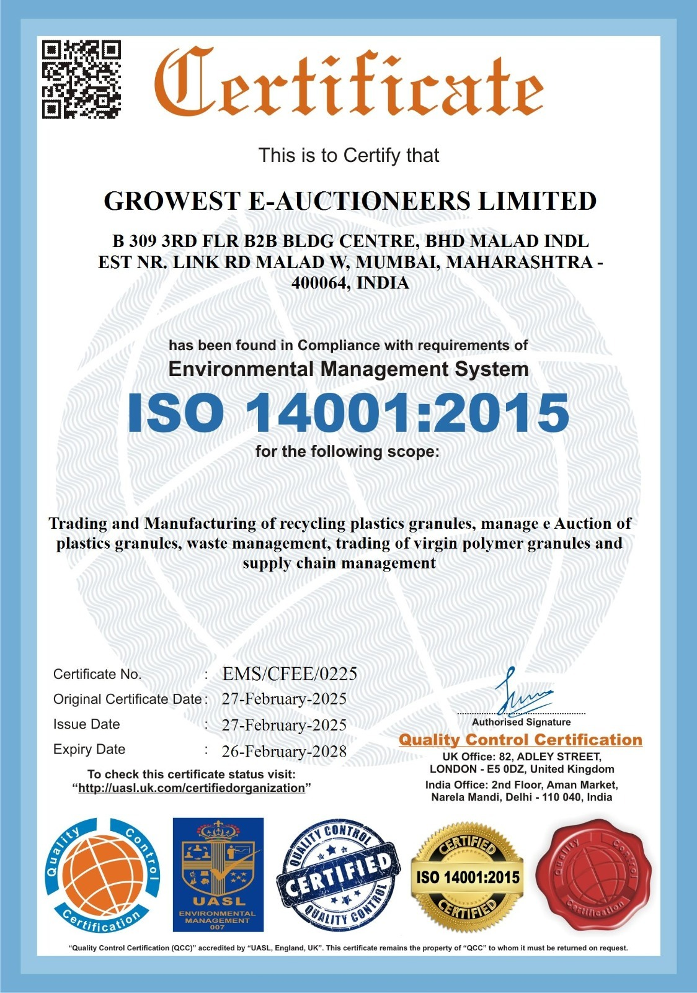
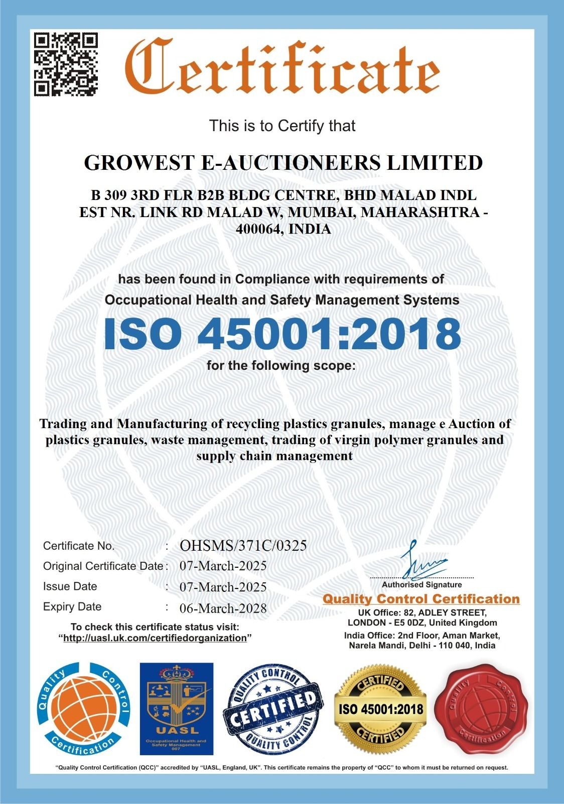
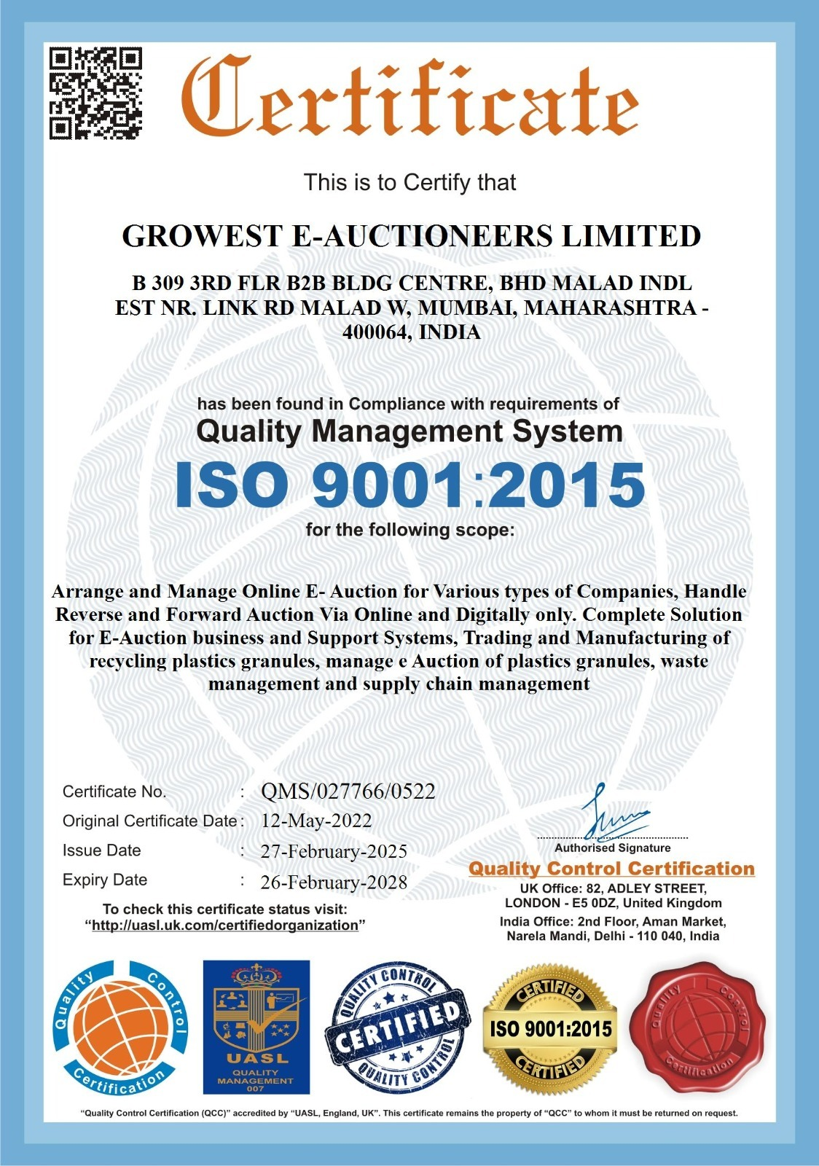
AWARDS AND RECOGNITION OF GROWEST E-AUCTIONEERS LIMITED
GROWEST E-AUCTIONEERS LIMITED has been honored with prestigious ISO certifications, recognizing its excellence in quality, environmental, and occupational health management. These awards highlight the company’s commitment to global standards and continuous improvement.

Slide 17
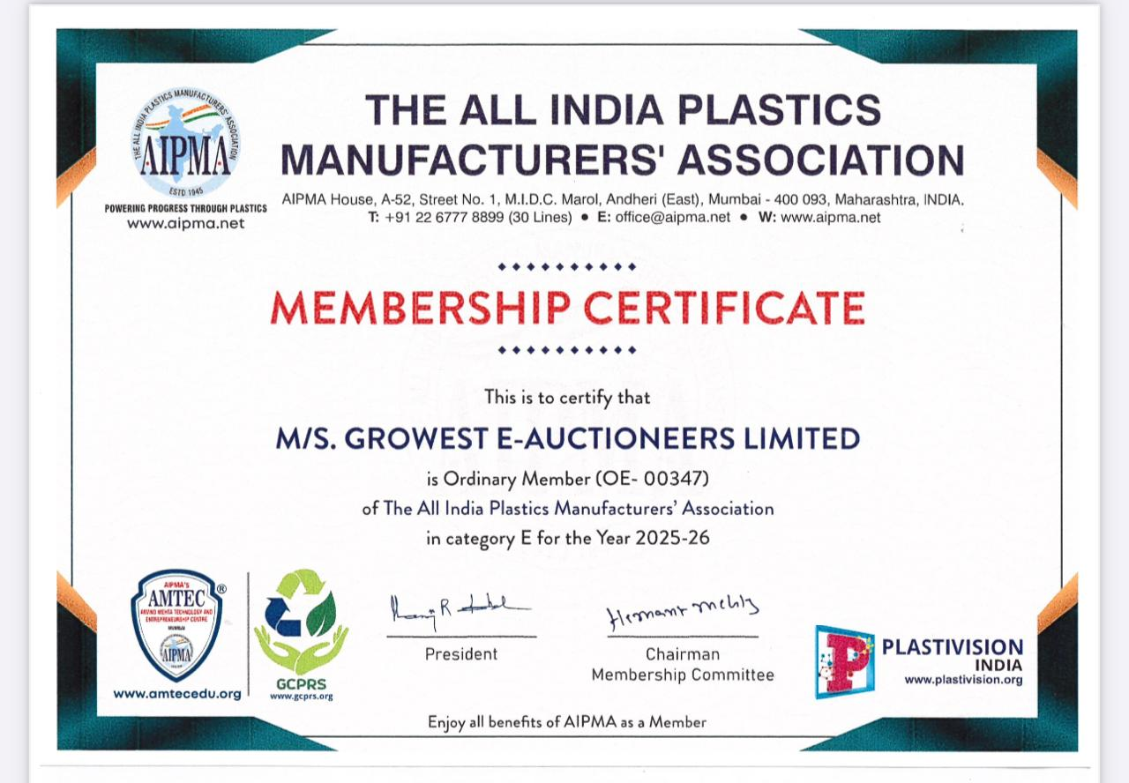
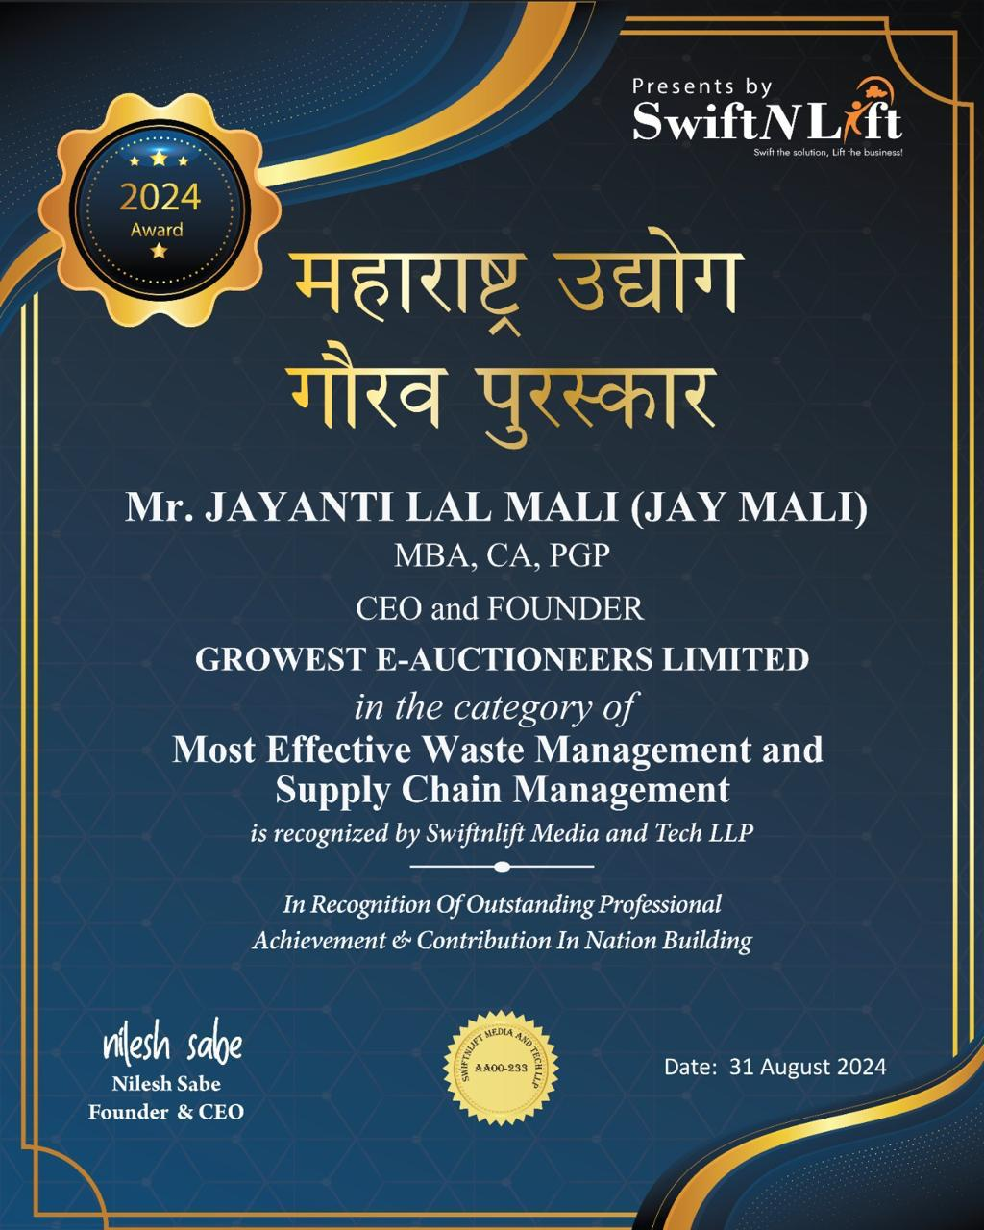
AWARDS AND RECOGNITION OF GROWEST E-AUCTIONEERS LIMITED

Slide 18
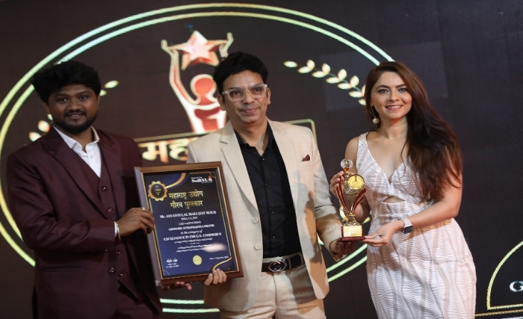
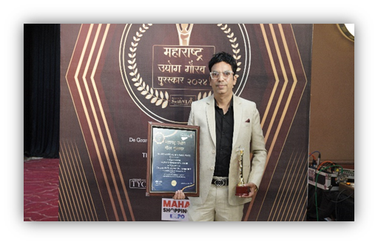
GROWEST E-AUCTIONEERS LIMITED Success Roaring High!
Our Founder Jayanti Lal Mali, was recently awarded the leading “Maharashtra Udyog Gaurav Purushkar” for Excellence in Product Quality and for his endless efforts in the success of GROWEST E-AUCTIONEERS LIMITED

Slide 19
MEET OUR CEO AND FOUNDER!
Jayanti Lal Mali, (Jay Mali) one of India's youngest successful entrepreneur, overcame early challenges to build the GrowIndia Group. With degrees in Commerce, Chartered Accountancy, CPA, MBA in Finance, and PGP in Strategic Management from EMAS Business School, Moscow, he transitioned from an employee in an Indian MNC to a visionary entrepreneur. Under his supervision businesses not only thrived but also set benchmark in their respective industries. Jay has proved via his entrepreneurial activities that it is possible to have a beneficial impact on the world while also attaining phenomenal commercial success. Jay aims to reach Rs. 10,000 crores by 2030, inspiring others with his story of perseverance and strategic acumen.
JAYANTI LAL MALI
Founder and CEO of
GrowIndia group

Slide 20
OUR LEADING TEAM
Shailesh, an Executive Director at GROWEST E-AUCTIONEERS LIMITED, manages overall factory operations, quality checks, product planning, and production processes. His strategic approach ensures seamless coordination between planning and execution, meeting operational requirements efficiently.
With a commitment to operational excellence, Shailesh plays a key role in maintaining production standards and ensuring timely delivery of high-quality products.
MR. SHAILESH KADAM

Slide 21
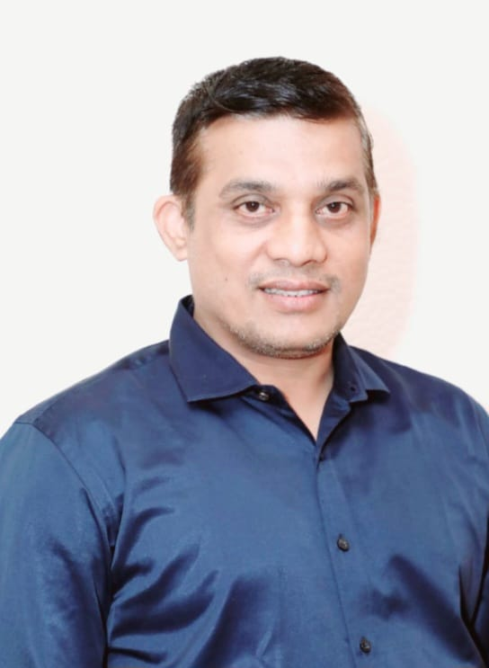
Mr. Greg, Executive Director at GROWEST E-AUCTIONEERS LIMITED, brings extensive experience in the polymer industry, particularly in production planning and manufacturing.
His expertise in costing and procurement enables the company to maintain competitive pricing while delivering top-quality recycled plastic products. Mr. Greg's strategic insights into process management contribute significantly to the company's growth and operational efficiency.
MR. GREG D’SOUZA

Slide 22
Sachin Mishra, also a General Manager at GROWEST E-AUCTIONEERS LIMITED, is responsible for managing commercial operations, accounting, cost analysis, and financial planning. His analytical skills and strategic financial management help the company optimize resources and drive profitability.
Working closely with other Executive Directors and the Managing Director, Sachin plays a crucial role in steering the company toward sustainable growth and success.
SACHIN MISHRA

Slide 23
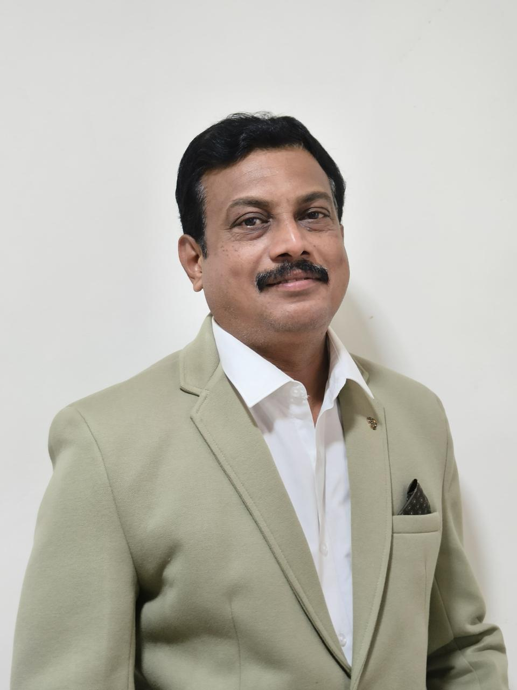
Nilesh Raut is a seasoned marketing and sales professional with over 25 years of experience in the plastic granules industry. Currently serving as the General Manager at Growest E-Auctioneers Limited, he brings deep industry knowledge, strategic insight, and a results-driven approach to the table.
Throughout his career, Nilesh has developed strong networks across the plastic manufacturing sector and has consistently delivered growth in both domestic and international markets. His expertise spans B2B sales, vendor development, pricing strategy, and digital transformation in industrial trade
NILESH RAUT

Slide 24
OUR CLIENTS

Slide 25
WHY WORK WITH GROWEST E-AUCTIONEERS LIMITED?
Experience
With years of expertise in the plastic industry, GROWEST E-AUCTIONEERS LIMITED delivers reliable solutions tailored to diverse client needs. Our experience drives innovation and excellence in every project.
Quality Products
We are committed to offering premium-grade plastic products that meet international standards. Every item is crafted with precision to ensure durability and performance.
High Quality Plastic Granules
Our state-of-the-art facilities produce uniform plastic granules, ensuring consistency and adaptability across various industries. These granules are eco-friendly and efficient for manufacturing.
24/7 Customer Support
Our dedicated team is available round the clock to address your queries and provide seamless assistance. Trust us for prompt and personalized support anytime.

Slide 26
CONTACT US:
GROWEST E-AUCTIONEERS LIMITED
info@growest.in www.growest.in
022 44516027/ +91 99200 09907 +91 99200 09901
Corporate Office: B-309 3RD FLOOR B2B BUSINESS CENTRE BHD MALAD INDUSTRIAL ESTATE NR LINK ROAD MALAD WEST MUMBAI-400064 MAHARASHTRA, INDIA
Plant: H3/H4 Rajlaxmi Sulzer Park, Village Gholgaon, Sonale, Bhiwandi, Thane, Maharashtra-421302
Tel: 02522 299833

Slide 27
Contact Us
THANK YOU!
info@growest.in
Visit Our Website
www.growest.in

